Slide 1

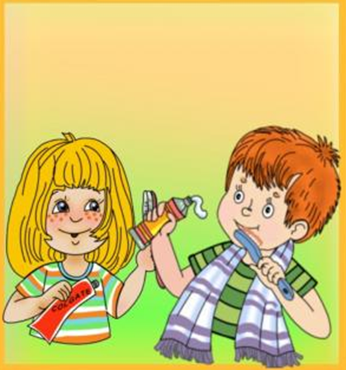

My Day

Slide 2
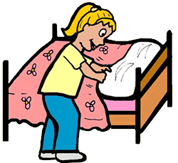

Slide 3
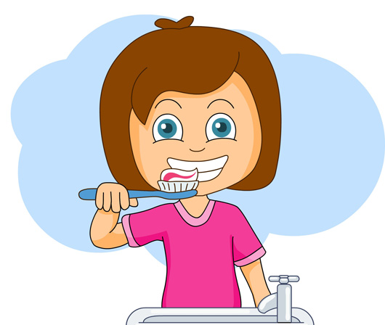

Slide 4
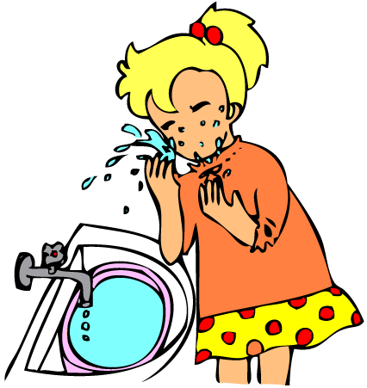

Slide 5
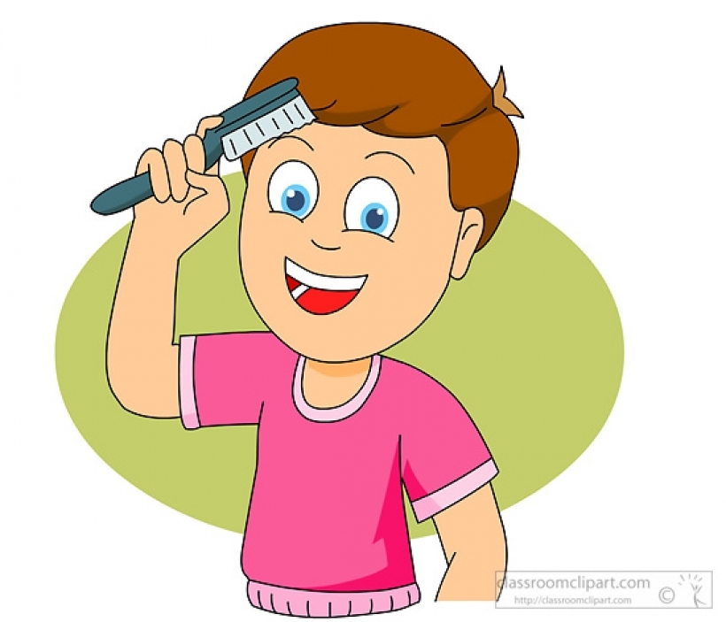

Slide 6
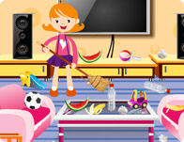

Slide 7


Slide 8
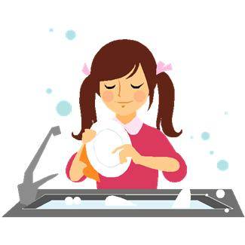

Slide 9
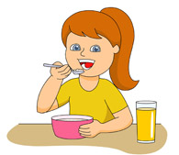

Slide 10
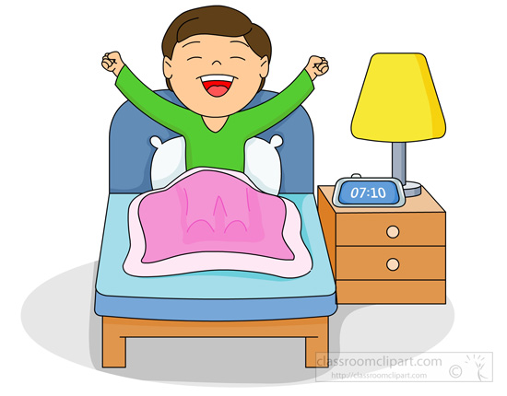

Slide 11
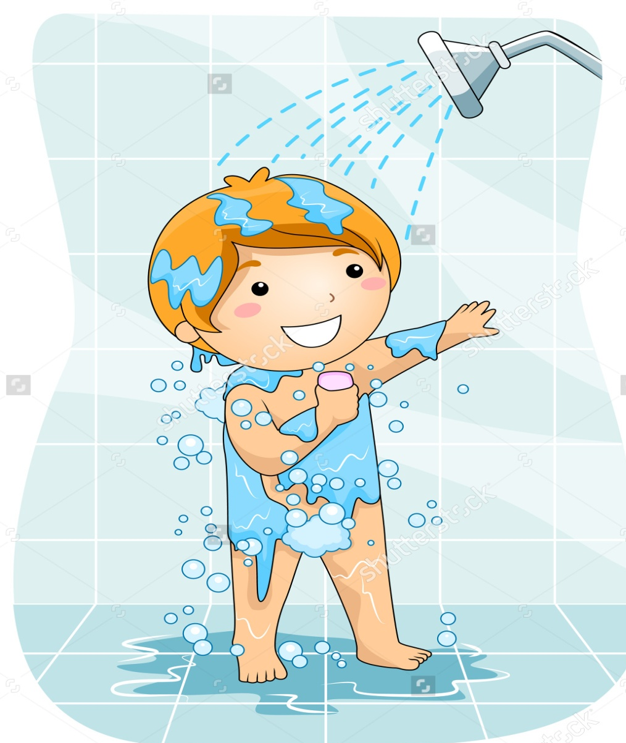

Slide 12
match
1. come A. to bed
2. tidy B. the dishes
3. do C. a shower
4. go D. home
5. take E. housework
6. wash F. the room

Slide 13
Fill in in the morning/ in the evening/ in the afternoon
1. We brush our teeth _______.
2. I go to bed _______.
3. I have lunch _________.
4. We come home from school ______.
5. I take a shower ______.

Slide 14
Choose the right preposition in for at
1. I get up ____ 9 o’clock.
2. We do exercises ____ the morning.
3. I have soup ____ dinner.
4. I tidy my room ___ the evening.
5. We have porridge ___ breakfast.

Slide 15
Noughts and crosses
 | a shower |  | breakfast | the dishes
home |  |  | housework | bed
 |  | teeth | school | the room

Slide 16
Answer the questions:
1.What does Kate do in the morning?
2.When does Kate get up?
3.What does Kate usually have for breakfast?
4.What does Emma do in the afternoon?
5.Where does Emma have lunch?
6.What does Emma do in the evening?

Slide 17

Cartoon

Slide 18
Answer the questions:
1.What does Kate do in the morning?
2.When does Kate get up?
3.What does Kate usually have for breakfast?
4.What does Emma do in the afternoon?
5.Where does Emma have lunch?
6.What does Emma do in the evening?

Slide 19
Work in pairs.
-When do you get up?
-I get up at 7.30
-What do you do in the morning?
-I get up, have breakfast and go to school.
-What do you usually have for breakfast?
-I eat meat and potatoes. I drink juice.
-What do you do in the evening?
-I do my homework and then play computer games. Let’s play computer games together!
-Let’s.

Slide 20


Moving activity

Slide 21
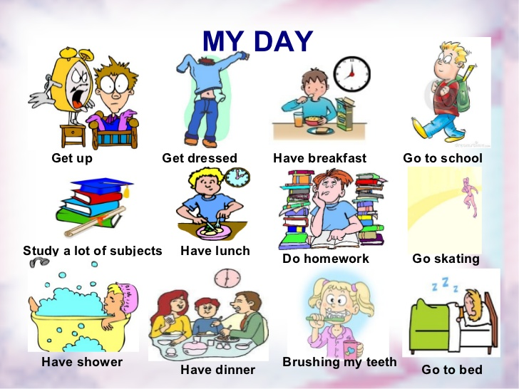
projects

Slide 22
My Day
At 8 sharp
I …………….. .
At 8.47.
I ………………
I go to school
In …………….. .
And in English today
I like to ………….
My work was fine,
So, I’ve got a ……..
(And today again
I’ve got a ……… .)

Slide 23
Thank you

